Slide 1
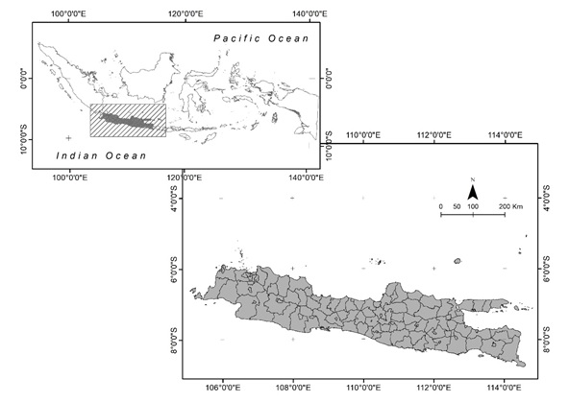

Slide 2
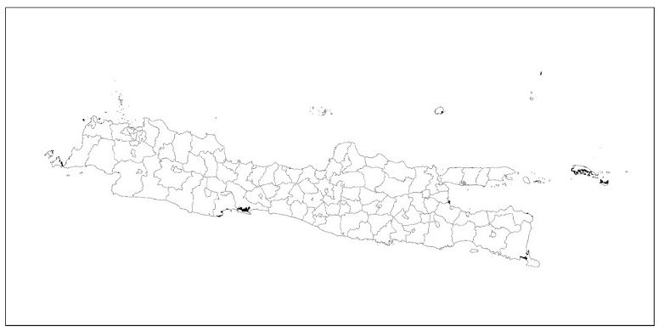
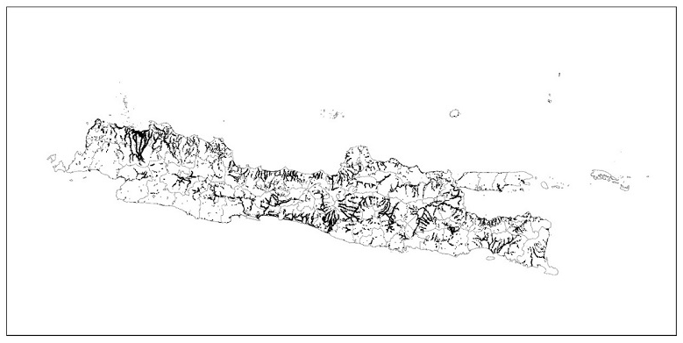
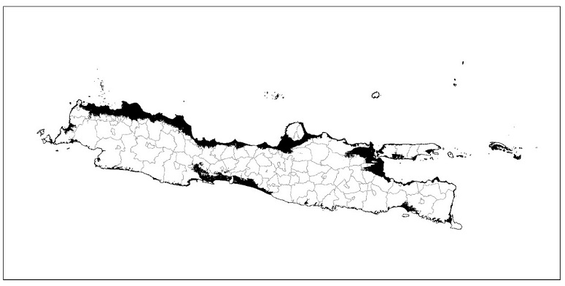
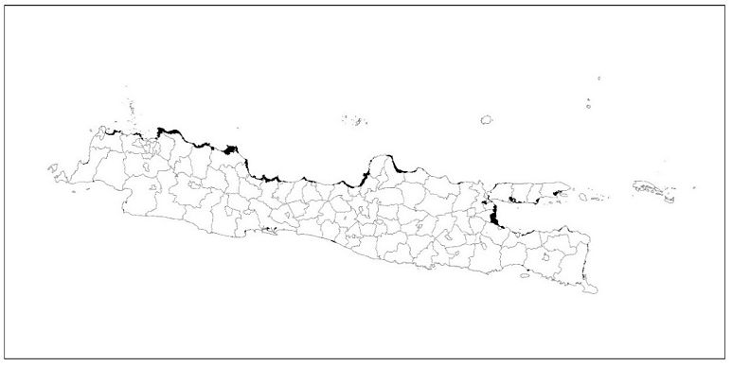
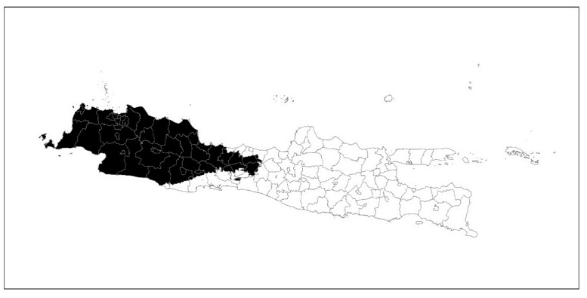
Primary and secondary Mangrove forest (a)
Watershed settlement (b)
Low-elevation area<10m above sea level (c)
Fishpond area (d)
Areas in which the annual precipitation will increase (e)

Slide 3
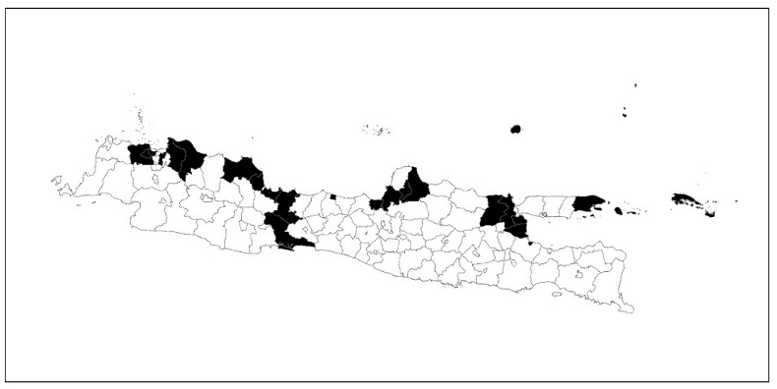
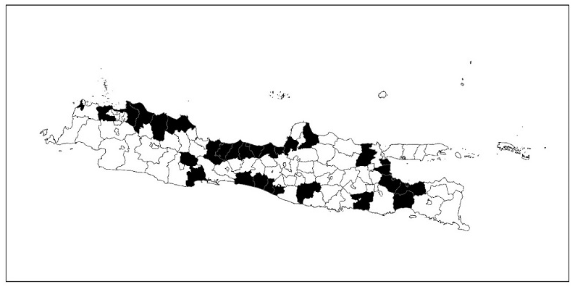
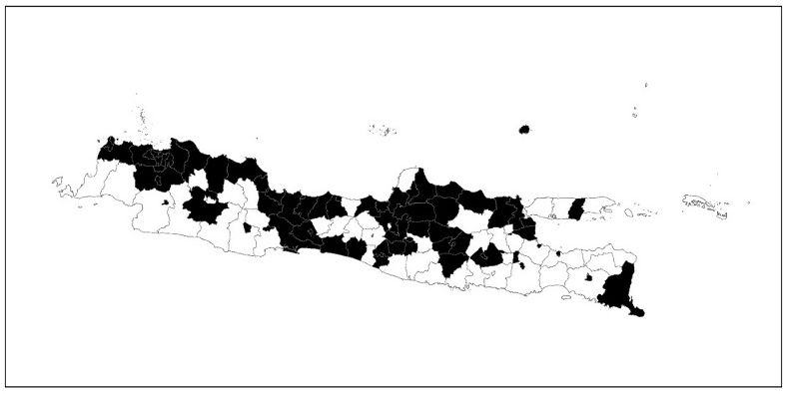
Priority areas based on scenario 1 (a)
Priority areas based on scenario 2 (b)
Priority areas based on scenario 3 (c)

